Slide 1
Classifying Brexit Tweets using Weak Social Supervision
CS-579 Project 2
Submitted by: Aman Agrawal (A20446346)

Slide 2
Overview
We know, most Machine Learning models are being trained on the datasets, that have been carefully prepared by the researchers all over the world.
However, getting these datasets and making them ready for an ML model to consume is quite a tedious process. This can be because of the following reasons:
Unavailability
Expensive
Time consuming
Weak supervision is a new programming paradigm suggested, to overcome this bottleneck for a large variety of problems

Slide 3
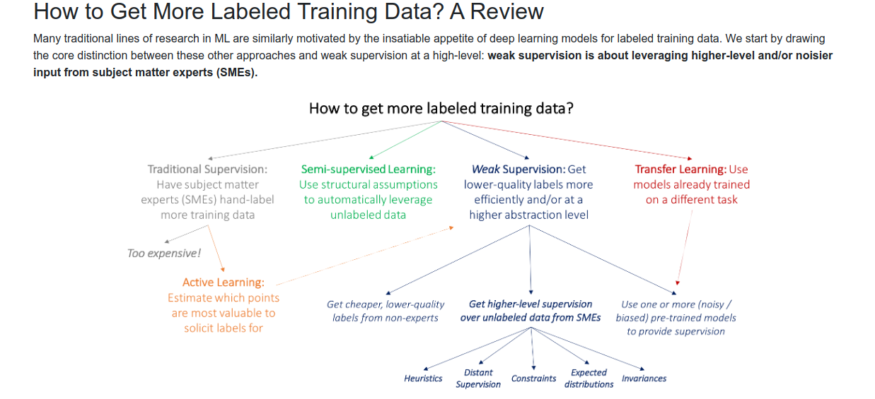
Image source: http://ai.stanford.edu/blog/weak-supervision/

Slide 4
Weak supervision in Social Media
Weak supervision finds its applications in tasks that require labeled dataset, but only an
unlabeled data is available, probably along with some form of supervision. This supervision can
be noisy, biased or both. In social media context, depending on the task at hand, examples of
weak social supervision may include:
Credibility and reliability of a user or a community
Frequency of generated posts
Comments, likes, dislikes, etc., on the generated post
The kind of audience targeted by the author of a post
Relationship between different entities in a social media network
Other heuristics and / or constraints

Slide 5
Classifying Brexit Tweets...

Slide 6
Dataset Information
A small sample of tweets (~800) taken from Twitter during the events of EU-Referendum in 2016
Out of these, only 130 (approximately) tweets are labeled.
The tweets are labeled with either ‘stay’ or ‘leave’, suggesting the intent of the tweet.

Slide 7
Steps followed
In order to implement the project, these steps were followed:
Generate labeling functions and train a labeling model using these labeling functions and the labeled subset (ground_truth) of the dataset.
This labeling model is in turn used to generate labels (albeit noisy) for the unlabeled subset of the dataset.
Fine-tune the labeling model/functions as necessary to maximize the coverage, and minimize the conflicts.
Combine the datasets (ground_truth and noisy labeled) to get a noisy dataset.
Preprocess the tweets to truncate informations such as: URLs, @mentions, #hashtags, etc.
Train a classifier first using only the ground_truth labels and then the combined dataset obtained above.
Obtain the results and compare their performance.

Slide 8
Implementation Details...

Slide 9
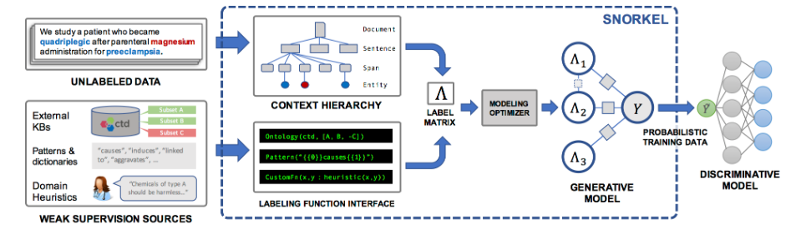
Snorkel
The Snorkel project started at Stanford in 2016, is a platform to build training data programmatically. This is done by providing weak supervision sources through Labeling Functions.
Image source: http://ai.stanford.edu/blog/weak-supervision/

Slide 10
Labeling functions
The labeling functions used in this project are:
Hashtag lookup for ‘stay’ class
Hashtag lookup for ‘leave’ class
Keyword lookup for ‘stay’ class
Keyword lookup for ‘leave’ class
Possible synonyms of keywords being looked up

Slide 11
Results...

Slide 12
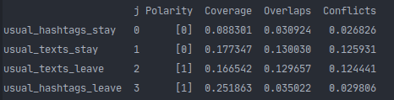
Labeling functions’ performance
Polarity:
⇒ 0: stay
⇒ 1: leave

Slide 13
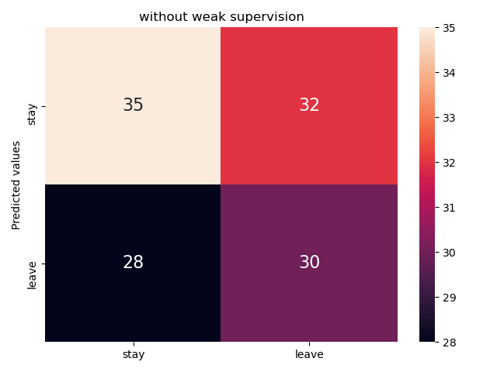
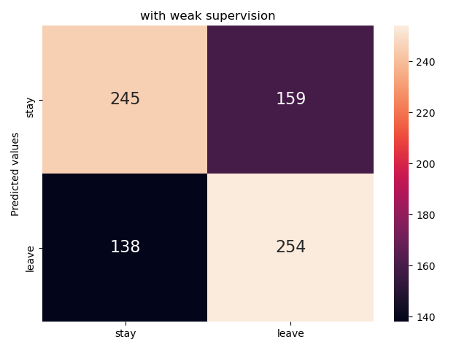
Classifier performance
Without weak social supervision
With weak social supervision

Slide 14
Thank you for listening!
Any questions?

